Slide 1
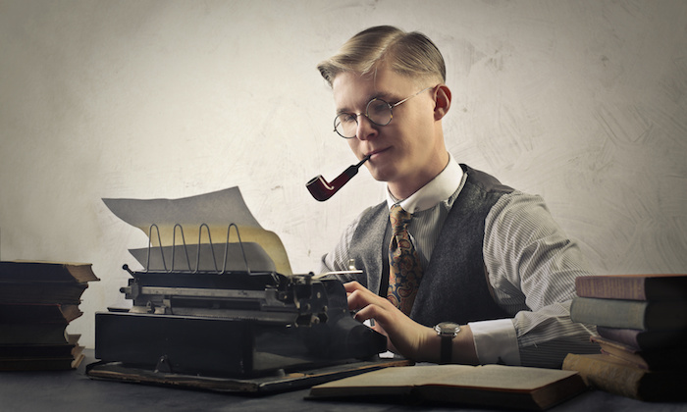
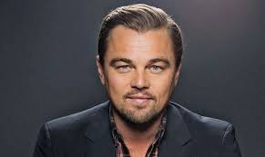
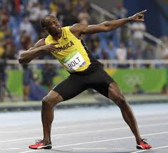
actor
athlete
writer

Slide 2
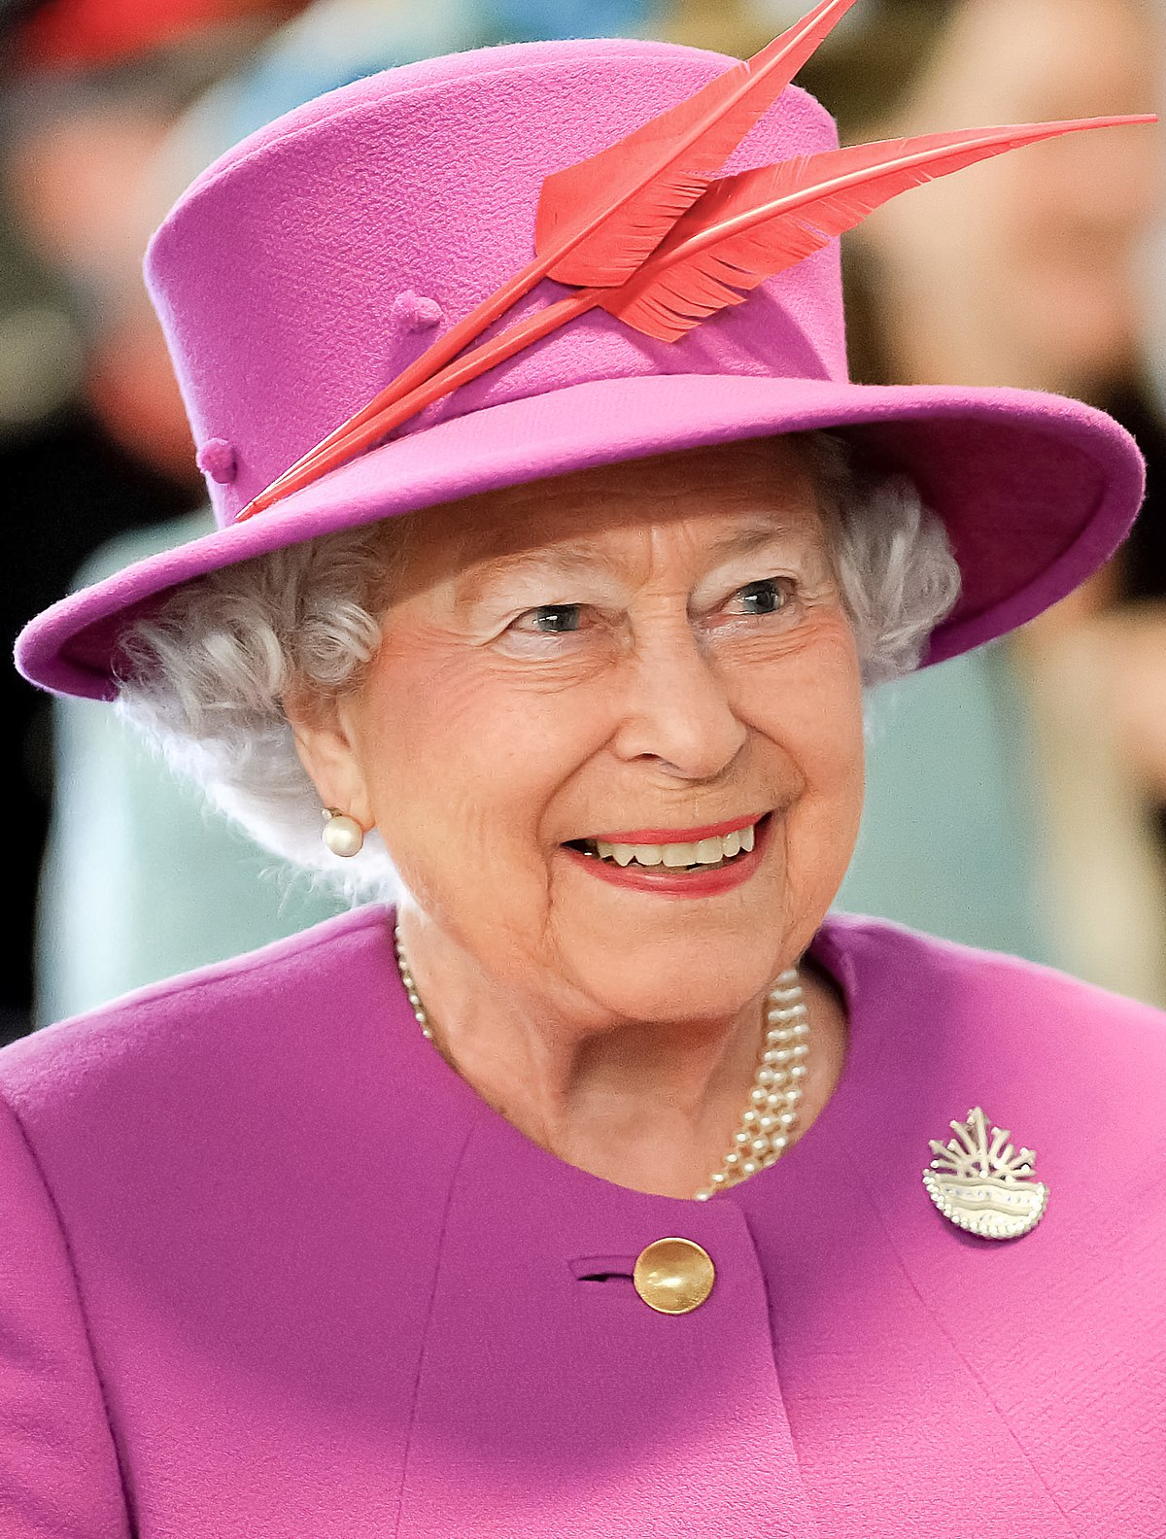
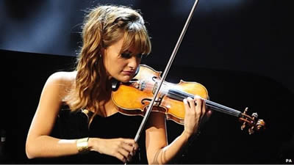
_ _ _ _ _
QUEEN
_ _ _ _ _ _ _ _
MUSICIAN

Slide 3
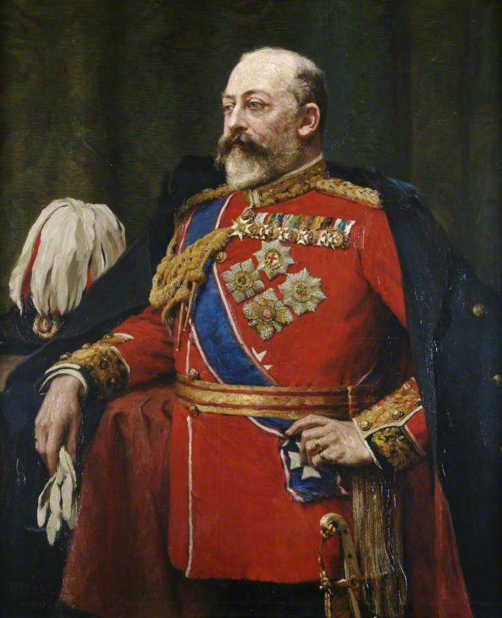
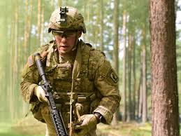
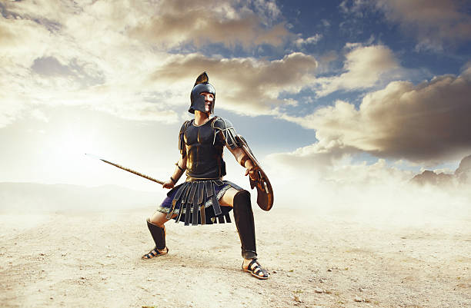
KING
SOLDIER
WARRIOR

Slide 4
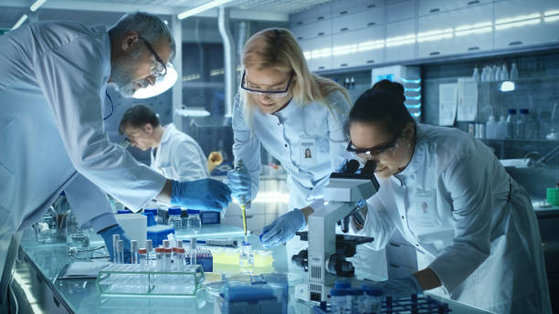
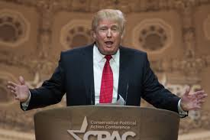
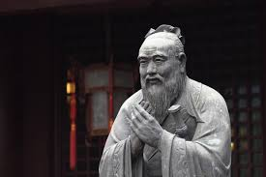
PHILOSOPHER
SCIENTIST
POLITICIAN

Slide 5
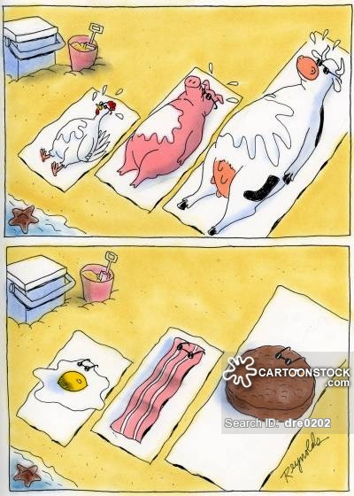
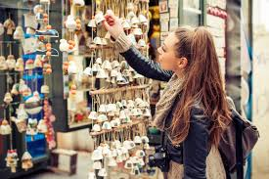
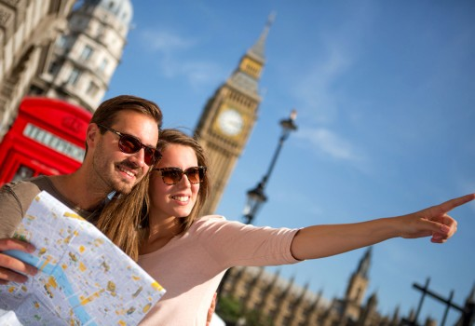
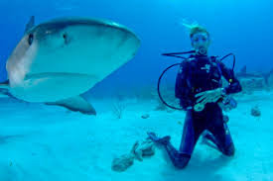
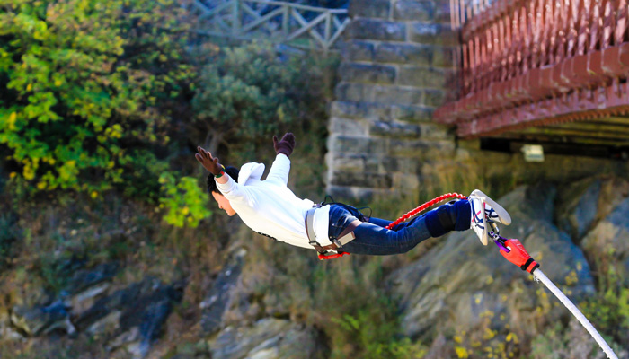
Buy souvenirs
Go sightseeing
sunbathe
Go diving
Go bungee jumping

Slide 6
Past simple

Slide 7
formula
S + WAS/WERE
S+ REGULAR VERBS
S + IRREGULAR VERBS

Slide 8
FORMS
AFFIRMATIVE S+ WAS/WERE(BE) S+ REGULAR VERBS S+ IRREGULAR VERBS | NEGATIVE S+ WASN’T/WEREN’T S+ DID NOT ( DIDN’T) + BASE VERB | INTERROGATIVE ( QUESTIONS) WAS/WERE + S…? DID + S + BASE VERB?

Slide 9
usage
Past events that no longer take any effect on present time.
Examples:
He was fat when he was 8 years old.
I went to school yesterday.
She didn’t go to university.

Slide 10
Time expression
Today is Monday
Sunday : yesterday
Saturday: the day before yesterday
Friday: two days AGO
LAST Sunday, Monday, …
LAST week, month, summer, year,...
IN, ON, AT + TIME IN THE PAST

Slide 11
Regular verbs
V+ ed
Pronunciation:
/t/ ed + ending sounds: /f/ (F), /p/ (P), /k/ (K,KE), /ʃ/ (SH), /s/ (X,S,CE, SE ( sometimes) ), /t̬ʃ/ (CH)
“Phở Pò Kho Sẵn Sàng Chưa?”
/id/ ed + T, Te, D, De
/d/ the others

Slide 12
dictation
Study –y +i + ed BUT play+ed
Stop + P + ed
Prefer + R + ed BUT reckon + ed
DancE + d

Slide 13
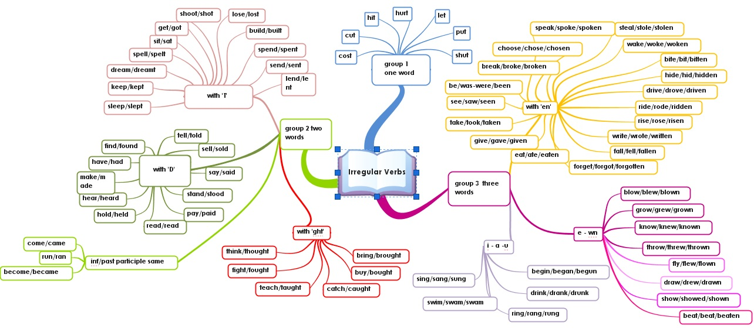
Irregular verbs

